Slide 1
Cellular
Lecture X
CS 168, Fall 2024 @ UC Berkeley
Slides credit: Sylvia Ratnasamy, Rob Shakir, Peyrin Kao, Raj Jain
Notes:
Slides template credit: Josh Hug, Lisa Yan
https://en.wikipedia.org/wiki/File:Wifiservice.svg

Slide 2
Brief History of Cellular Networks
Why is Cellular Different?
Brief History
Standards
Challenge: Mobility
Cellular Networks
Infrastructure
High-Level View
Step 0: Registration
Step 1: Discovery
Step 2: Attachment
Step 3: Data Exchange
Step 4: Handover
Roaming and Other Features
Lecture X, CS 168, Fall 2024

Slide 3
Why Study Cellular?
Goal: Wireless mobile connectivity, e.g. watching video in a moving car.
Cellular is the dominant approach today.
Over 50% of web traffic originates from a cellular device!
Other technologies (e.g. satellite) also exist.
Active area of research!
New bandwidth-intensive mobile apps, e.g. virtual reality, self-driving cars.
Cellular network is facing severe scaling challenges.
Deploying towers and buying spectrum is expensive.
Traditional operators (AT&T, Verizon) don't have a reputation for rapid innovation.
Mobile Wireless Access
The whole area is ripe for disruption!
Our focus today.
Cellular
Free-Space Optics
Satellite

Slide 4
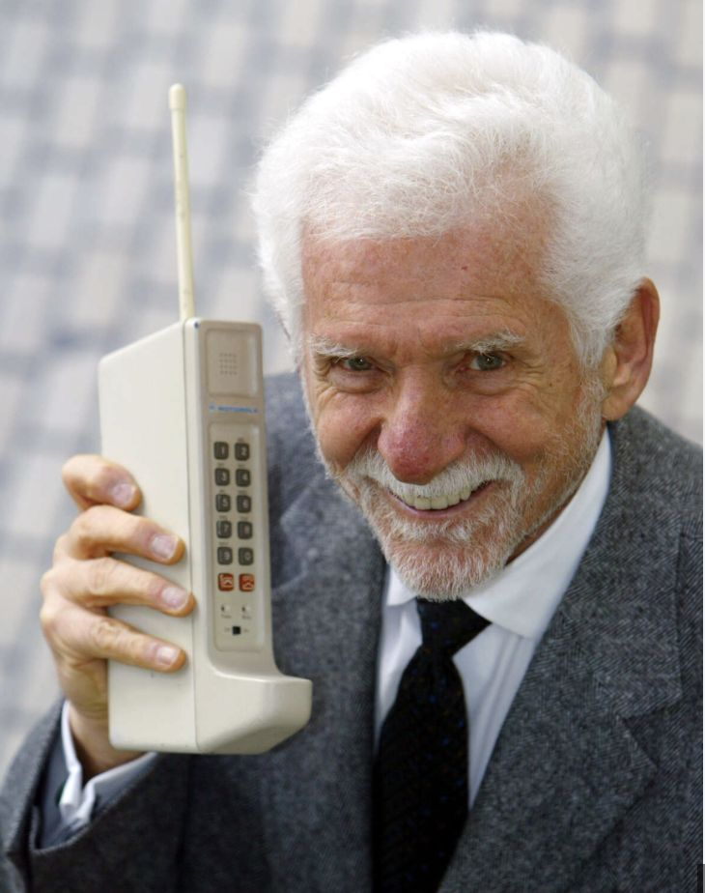
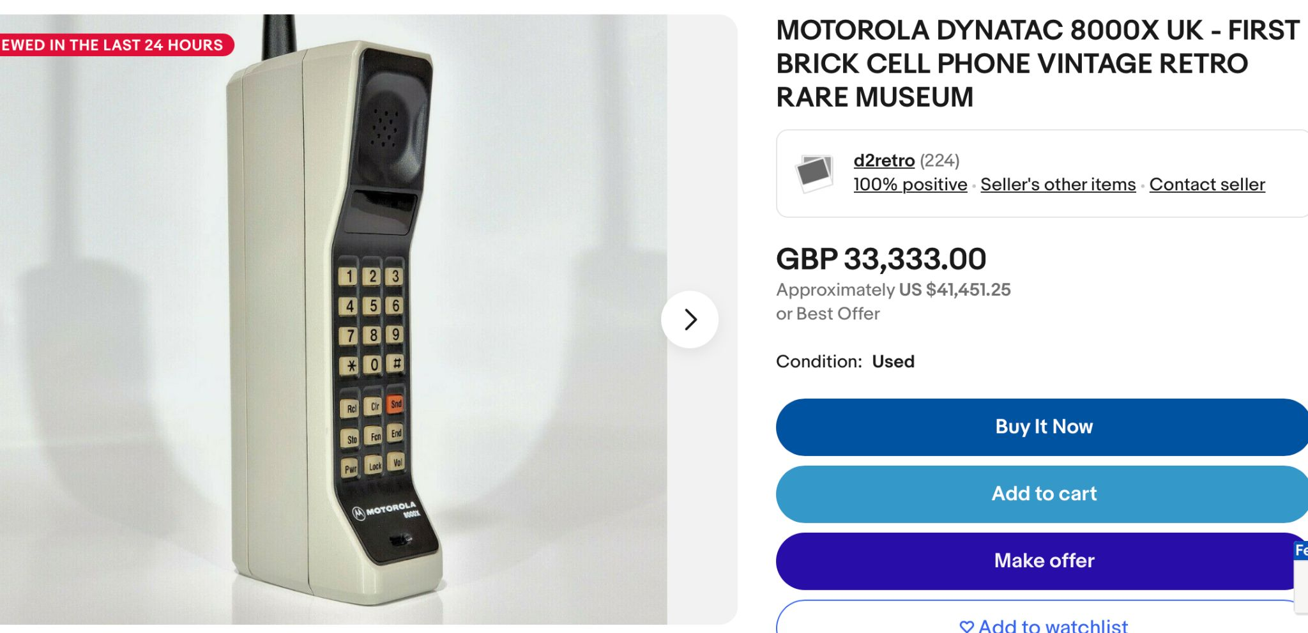
Brief History of Cellular Networks
Cellular networks are derived from the old telephone network.
Original purpose: Make phone calls wirelessly.
Martin Cooper made the first mobile call on this Motorola phone.
Sold for $4,000 in 1983 (over $12,000 today).
Apparently worth over $40,000 today as an antique.

Slide 5
Brief History of Cellular Networks
Roots in the telephone network led to design choices that differ from the Internet.
Cellular networks:
Resource reservations.
Per-user state in the network.
Emphasis on accountability.
The Internet:
Best-effort.
Per-flow or per-packet state.
Doesn't really track usage per user.
In recent years, cellular networks evolved to be more compatible with the Internet.
Today, can think of cellular networks as Layer 2 networks within the Internet.

Slide 6
Cellular Network Standards
Why is Cellular Different?
Brief History
Standards
Challenge: Mobility
Cellular Networks
Infrastructure
High-Level View
Step 0: Registration
Step 1: Discovery
Step 2: Attachment
Step 3: Data Exchange
Step 4: Handover
Roaming and Other Features
Lecture X, CS 168, Fall 2024

Slide 7
Cellular Standards Bodies
3GPP (3rd Generation Partnership Project) consortium oversees standardization efforts.
Includes equipment vendors and telecommunications companies.
Everyone must agree on protocols to achieve interoperability.
Standards ratified by ITU (International Telecom Union), part of the United Nations.
Politics are involved in approving standards!

Slide 8
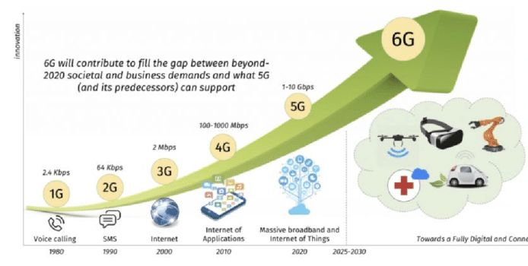
Cellular Standards Evolution
New generation every 10 years: 1G, 2G, 3G, 4G, 5G.
5G introduced in 2019, still being deployed.
6G coming in 2030.
The marketing view: Every generation is better than the last!

Slide 9
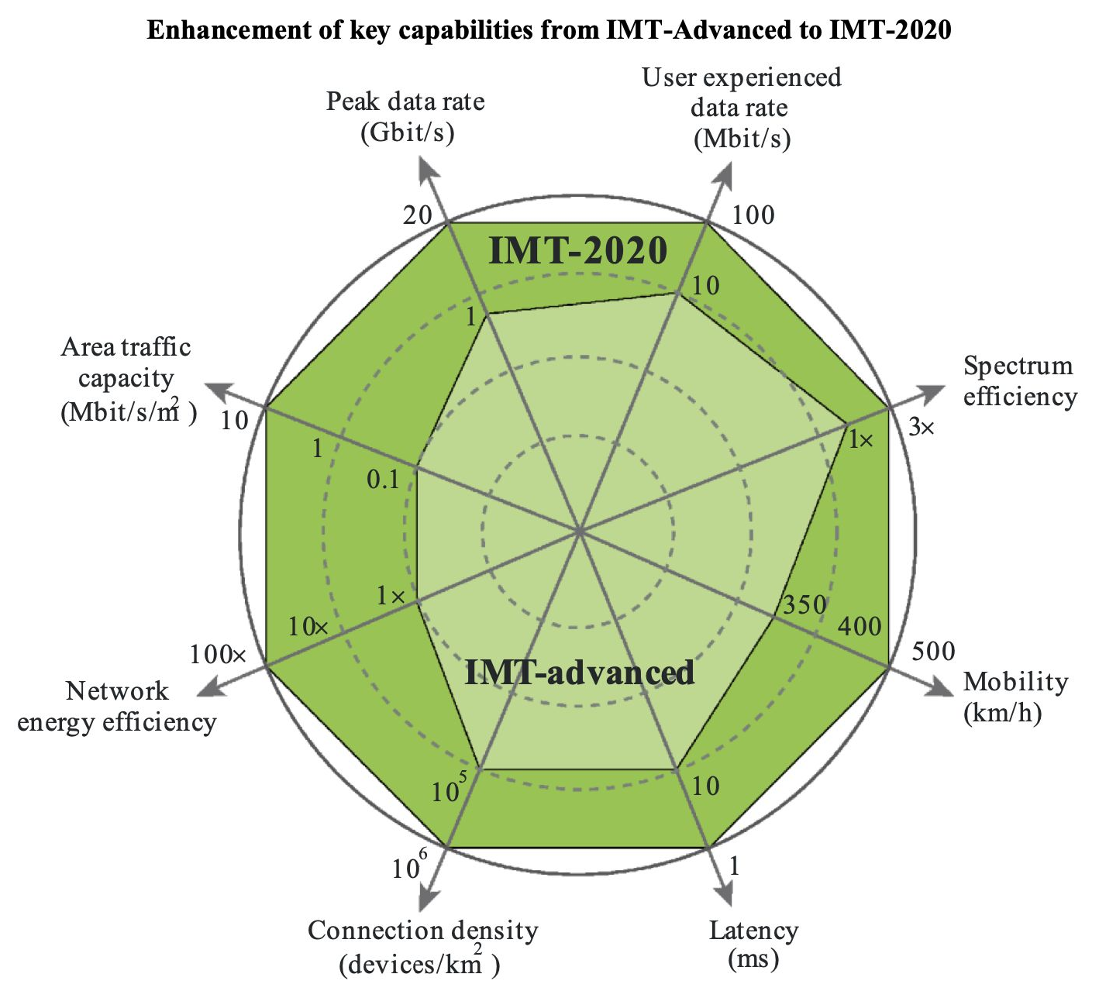
Cellular Standards Evolution
Each generation aims for a ~10x improvement along a few different dimensions:
Peak theoretical data rate.
Average data rate experienced by users.
Mobility: Connection while user travels at high speed.
Connection density: Number of devices in a specific era.
etc.
Light green = 4G quality along 8 different dimensions.
Dark green = 5G quality along those same dimensions.

Slide 10
Cellular Standards Evolution
In addition to performance evolution, there's also been an architectural evolution:
1G:
Analog.
Designed for voice calls.
2G/3G:
Mostly circuit-switched.
Focused on voice traffic. Some texting. Barely any Internet access.
LTE/4G onwards:
Packet-switched.
Voice just one of many different applications.

Slide 11
Cellular Standards Specifications
Cellular specifications are long and complicated.
Hundreds of documents. Thousands of pages.
Endless acronyms.
Obscure naming conventions.
Components/protocols are renamed in every generation!
"Base station" → "NodeB" → "evolved Node B (eNodeB)" → next-gen Node B (gNB)
In this class, we'll exercise some poetic license and invent our own terminology.
Loosely based on the LTE architecture.
Conceptually correct, but not an exact match to textbooks and real standards.

Slide 12
Challenge: Mobility
Why is Cellular Different?
Brief History
Standards
Challenge: Mobility
Cellular Networks
Infrastructure
High-Level View
Step 0: Registration
Step 1: Discovery
Step 2: Attachment
Step 3: Data Exchange
Step 4: Handover
Roaming and Other Features
Lecture X, CS 168, Fall 2024

Slide 13
Key Challenge: Mobility
What fundamental new requirements does mobility introduce?
Discovery: What cell tower should a mobile device connect to?
Authentication: Should the tower provide service to this device?
Seamless communication: No disruption to new/ongoing application sessions.
Accountability: Enforcing resource limits based on the user's service plan.

Slide 14
Cellular Infrastructure
Why is Cellular Different?
Brief History
Standards
Challenge: Mobility
Cellular Networks
Infrastructure
High-Level View
Step 0: Registration
Step 1: Discovery
Step 2: Attachment
Step 3: Data Exchange
Step 4: Handover
Roaming and Other Features
Lecture X, CS 168, Fall 2024

Slide 15
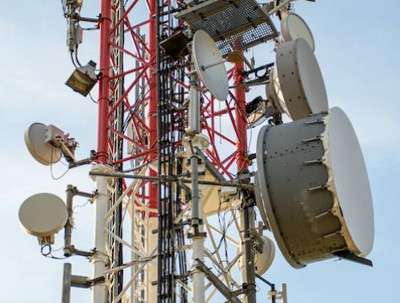
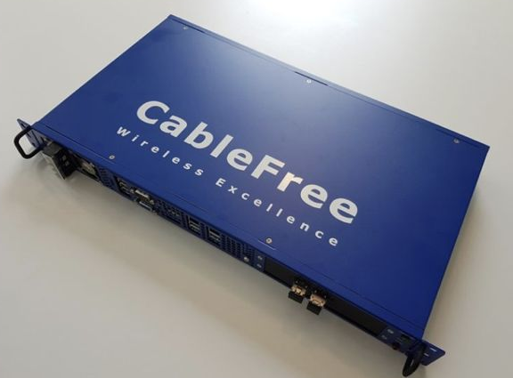
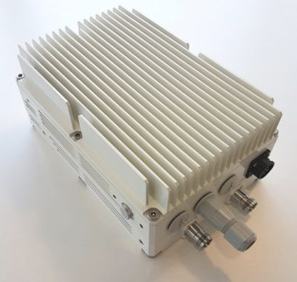
Infrastructure Components (1/5): Radio Towers
Inside a radio tower:
Radio transceiver: Converts data to signals sent over the air interface.
Radio controller: Decides how to allocate radio resources.
Traditionally near the tower, but sometimes in the cloud now.
Radio Tower
Antenna
Transceiver
Controller
Range of tower

Slide 16
Infrastructure Components (1/5): Radio Towers
Simplified model: Radio controller is like a CPU running a scheduler.
Decide who gets to transmit when, and on what frequency.
Each block represents one part of the spectrum at one time slot.
...at these times.
Purple user gets these frequencies...
Frequency
Time

Slide 17
Infrastructure Components: Radio Access Network
Each operator has a radio access network of many towers.
Neighboring towers are assigned non-overlapping frequency ranges.
Towers in more populated areas can get allocated more frequencies.
Cellular Radio Access Network (RAN)

Slide 18
Infrastructure Components: Cellular Core
The cellular core is the "backend" of the cellular network.
R1
To Internet
P1
R2
Mobility Manager
Database
Cellular Radio Access Network (RAN)
Cellular Core

Slide 19
Infrastructure Components (2/5 and 3/5): Radio Gateway, Packet Gateway
Data-plane components (routers):
Radio gateway: Boundary between RAN and core.
Packet gateway: Boundary between cellular network and rest of Internet.
Wired links between towers and radio gateways.
R1 and R2 are radio gateways.
P1 is the packet gateway. (There could be multiple).
R1
To Internet
P1
R2
Mobility Manager
Database
Cellular Radio Access Network (RAN)
Cellular Core

Slide 20
Infrastructure Components (4/5 and 5/5): Mobility Manager, Database
Control-plane components:
Mobility manager: Handles authentication, mobility, location tracking, etc.
Database: Stores information about customers.
Manager can configure gateways and towers.
R1
To Internet
P1
R2
Mobility Manager
Database
Manager can access database.
Cellular Radio Access Network (RAN)
Cellular Core

Slide 21
Infrastructure Components: Summary
Cell towers (arranged in a RAN).
Data plane: Radio gateways, packet gateways.
Control plane: Mobility manager, database.
R1
To Internet
P1
R2
Mobility Manager
Database
Cellular Radio Access Network (RAN)
Cellular Core

Slide 22
High-Level View
Why is Cellular Different?
Brief History
Standards
Challenge: Mobility
Cellular Networks
Infrastructure
High-Level View
Step 0: Registration
Step 1: Discovery
Step 2: Attachment
Step 3: Data Exchange
Step 4: Handover
Roaming and Other Features
Lecture X, CS 168, Fall 2024

Slide 23


High-Level View (0/4) – Registration
Step 0: Registration.
User registers for the service. Database is updated.
R1
P1
R2
Mobility Manager
Database

Slide 24
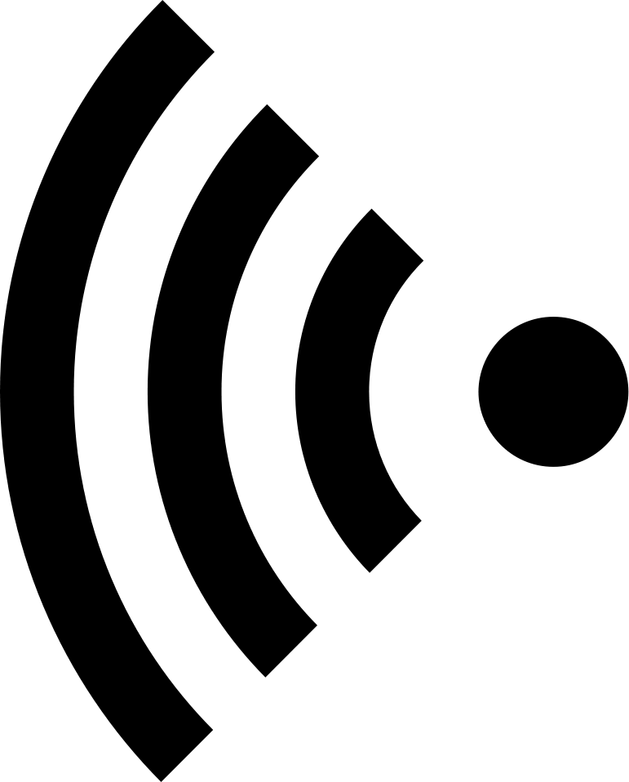
High-Level View (1/4) – Discovery
Step 1: Discovery.
User wants to connect.
User device discovers available towers and picks one.
R1
P1
R2
Mobility Manager
Database

Slide 25
High-Level View (2/4) – Attachment
Step 2: Attachment.
Device asks the tower to connect.
Tower checks with mobility manager if connection is allowed.
R1
P1
R2
Mobility Manager
Database

Slide 26
High-Level View (2/4) – Attachment
Step 2: Attachment.
If manager approves request, it configures a path between user and Internet.
R1
P1
R2
Mobility Manager
Database

Slide 27
High-Level View (3/4) – Data Exchange
Step 3: Data exchange.
User can now send and receive data!
Packets travel along the path configured in previous step.
R1
P1
R2
Mobility Manager
Database

Slide 28
High-Level View (4/4) – Handover
Step 4: Handover.
Device might move away from old tower, closer to a new tower.
Device, old tower, new tower, and manager work together to switch towers.
R1
P1
R2
Mobility Manager
Database

Slide 29
High-Level View (4/4) – Handover
Step 4: Handover.
Manager configures a new path through the network for the user.
Handover must be seamless. We can't interrupt the user's connection!
User's IP address should stay the same.
R1
P1
R2
Mobility Manager
Database

Slide 30
High-Level View (4/4) – Handover
After handover, user has a new path through the network.
Step 3 (Data Exchange) and Step 4 (Handover) repeat as the user moves around.
R1
P1
R2
Mobility Manager
Database

Slide 31
High-Level View – Roaming
One last feature is roaming: User connecting to a different network.
Example: User visiting a different country.
Mostly works the same as what we've seen.
Main difference: Managers in the visited and home networks must coordinate.
Internet
R1
Visited network
P1
R2
R1
P1
DB
Manager
R2
Home network
Manager
DB

Slide 32
Step 0: Registration
Why is Cellular Different?
Brief History
Standards
Challenge: Mobility
Cellular Networks
Infrastructure
High-Level View
Step 0: Registration
Step 1: Discovery
Step 2: Attachment
Step 3: Data Exchange
Step 4: Handover
Roaming and Other Features
Lecture X, CS 168, Fall 2024

Slide 33
Identifying User Devices: IMSI
When you register for a service, you receive an IMSI (International Mobile Subscriber Identity).
Uniquely identifies a user's subscription.
Securely stored in hardware (SIM) card.
IMSI stays the same if you switch phones, but keep the same service plan.
IMSI (no more than 15 digits)
MCC (3 digits)
MNC (2–3 digits)
MSIN (9–10 digits)
Mobile Country Code
Mobile Network Code
Mobile Subscriber Identification Number

Slide 34
Identifying User Devices: IMSI, IMEI, IP, MSISDN
Different ways to identify a user device:
IMSI: Identifies a user subscription.
IP address: Assigned on attachment, typically retained across handovers.
Can change each time you attach to the network.
IMEI (International Mobile Equipment Identity): Identifies a physical device.
Identifies device manufacturer and model.
Burned into hardware. Stays the same even if you switch plans.
MSISDN: Your phone number.
Operator maps your phone number to your IMSI.

Slide 35
Step 0: Registration
User registers for the service.
Operator stores user's IMSI and plan information in the database.
Establishes a shared key known only by the user and operator.
User: Stored in SIM card.
Operator: Stored in database.
R1
P1
R2
Mobility Manager
Database

Slide 36
Step 1: Discovery
Why is Cellular Different?
Brief History
Standards
Challenge: Mobility
Cellular Networks
Infrastructure
High-Level View
Step 0: Registration
Step 1: Discovery
Step 2: Attachment
Step 3: Data Exchange
Step 4: Handover
Roaming and Other Features
Lecture X, CS 168, Fall 2024

Slide 37
Step 1: Discovery
Towers transmit periodic beacons to announce their presence.
Beacons transmitted on a dedicated control channel.
Avoids interfering with data.
Each frequency range has its own control channel. Avoids beacons interfering with each other.
Beacons identify the network operator.
User compares beacon against the network ID (in the user's IMSI).
User measures signal strength to different towers, and picks the tower (belonging to its operator) with the best signal.

Slide 38
Discovery: Finding Control Channel
Bootstrapping problem: How does the user know which control channel to listen to?
Scan all frequencies.
Slow, but sometimes unavoidable.
At registration, pre-configure device with a list of frequency channels.
Cache previously-used channels.
Note: During handovers, the old tower tells the user the channel on the new tower.
No need to scan! Handovers take 0.01s–0.1s.
Contrast with attachment, which takes 10s–100s.

Slide 39
Step 2: Attachment
Why is Cellular Different?
Brief History
Standards
Challenge: Mobility
Cellular Networks
Infrastructure
High-Level View
Step 0: Registration
Step 1: Discovery
Step 2: Attachment
Step 3: Data Exchange
Step 4: Handover
Roaming and Other Features
Lecture X, CS 168, Fall 2024

Slide 40
Step 2: Attachment
1. User sends attach request to tower, containing user's IMSI.
2. Tower forwards request to mobility manager.
3. Mobility manager processes the request, by looking up the IMSI in database.
Use secret key to authenticate: Is the user who they claim to be?
Use database to check service parameters: Did user pay their bills?
1
R1
P1
2
R2
Mobility Manager
3
Database

Slide 41
Step 2: Attachment
4. If request is approved, mobility manager configures the data plane.
Assign an IP address to the user.
Tell the tower how many resources to allocate for this user.
Configure tower and routers to create a path from user to Internet.
Initialize counters to track the device's usage.
R1
P1
R2
Mobility Manager
Database

Slide 42
Step 2: Attachment
5. If request is approved, mobility manager records information in the database, mapping the user's IMSI to their current:
Location (tower).
Path to the Internet (radio gateway, packet gateway).
IP address.
R1
P1
R2
Mobility Manager
Database

Slide 43
Step 2: Attachment
1. User sends attach request to tower, containing user's IMSI. 2. Tower forwards request to mobility manager. 3. Mobility manager processes the request, by looking up the IMSI in database. 4. If request is approved, mobility manager configures the data plane. 5. If request is approved, mobility manager records information in the database.
Note: All communication so far is over dedicated control channels.
1
R1
P1
4
4
R2
2
4
Mobility Manager
5
Database
3

Slide 44
Step 3: Data Exchange
Why is Cellular Different?
Brief History
Standards
Challenge: Mobility
Cellular Networks
Infrastructure
High-Level View
Step 0: Registration
Step 1: Discovery
Step 2: Attachment
Step 3: Data Exchange
Step 4: Handover
Roaming and Other Features
Lecture X, CS 168, Fall 2024

Slide 45
Step 3: Data Exchange
Device can now send and receive packets with its IP address!
How does the network know how to forward packets?
Users are constantly moving.
Traditional routing algorithms won't converge.
R1
P1
R2

Slide 46
Step 3: Data Exchange with Tunnels
Solution: Mobility manager configures a path from user to Internet using tunnels.
Result is different from traditional IP networks:
No direct forwarding on the user's IP address!
Requires installing per-user state in the network.
If I get a packet exiting the pink tunnel, send it into the green tunnel.
If I get a packet exiting the green tunnel, send it into the blue tunnel.
R1
P1
R2

Slide 47
Step 3: Data Exchange with Tunnels
How do we tell if a packet is traveling through a tunnel? Use encapsulation.
User sends plain IP packet. No need to think about tunnels.
Cellular network adds extra header.
Packet forwarded through cellular network. No need to think about user IP!
Extra header removed, and plain IP packet sent to rest of Internet.
Blue Tunnel
Blue Tunnel
User's IP
[Payload]
User's IP
[Payload]
User's IP
[Payload]
User's IP
[Payload]
Blue Tunnel
User's IP
[Payload]
User's IP
[Payload]
R1
P1
R2

Slide 48
Step 4: Handover
Why is Cellular Different?
Brief History
Standards
Challenge: Mobility
Cellular Networks
Infrastructure
High-Level View
Step 0: Registration
Step 1: Discovery
Step 2: Attachment
Step 3: Data Exchange
Step 4: Handover
Roaming and Other Features
Lecture X, CS 168, Fall 2024

Slide 49
Step 4: Handover
Mobility Manager
6. I'm the new tower for the user.
Update user location in database. Configure new path between user and Internet.
Old Tower
Device
New Tower
1. Your signal strength is low. Measure signal to other towers.
2. Here's my signal strength to other towers.
3. User is coming your way...
4. OK. Here are radio slots for the user.
5. Connect to new tower using these slots.
7. Handover complete!

Slide 50
Step 4: Handover
Handover is complicated.
Cooperative process between user, towers, manager, and gateways.
More involved when we have to change the radio or packet gateways being used.
Handover must be seamless.
User's IP address cannot change.
User is still sending/receiving data during handover.
Old tower can buffer data it receives during handover.
After handover, old tower transfers buffer to new tower.
Decisions are made by the operator.
Device reports signal strength, but old tower chooses the new tower.
Benefit: Operator has more control, e.g. for load-balancing.
Drawback: Slower, requires extra round-trips.

Slide 51
Roaming and Other Features
Why is Cellular Different?
Brief History
Standards
Challenge: Mobility
Cellular Networks
Infrastructure
High-Level View
Step 0: Registration
Step 1: Discovery
Step 2: Attachment
Step 3: Data Exchange
Step 4: Handover
Roaming and Other Features
Lecture X, CS 168, Fall 2024

Slide 52
Roaming
Visitor and home networks must establish a roaming agreement.
Visited network uses device's network code (in IMSI) to learn the home network.
Need home network's help to authenticate user.
Need to update home network's database with user's location.
Internet
R1
Visited network
R2
P1
R3
P2
DB
Manager
R4
Home network
Manager
DB

Slide 53
Roaming
Two common ways to configure path from user to Internet.
Home routing: Tunnel traffic through the home network's packet gateway.
Benefit: Home network can track user.
Drawback: Packets takes longer path to Internet.
Internet
R1
Visited network
R2
P1
R3
P2
DB
Manager
R4
Home network
Manager
DB

Slide 54
Roaming
Two common ways to configure path from user to Internet.
Local breakout: Tunnel traffic through the visitor network's packet gateway.
Drawback: Harder for home network to track user.
Benefit: Packets takes shorter path to Internet.
Internet
R1
Visited network
R2
P1
R3
P2
DB
Manager
R4
Home network
Manager
DB

Slide 55
Additional Operations
Other operations in cellular networks:
Lawful intercept:
Allows law enforcement to wiretap specific subscribers.
Operators must be able to fulfill wiretap requests.
Stolen phone registries:
Users can report their phone stolen.
If someone connects stolen phone to network, the phone can be tracked.
Use IMEI (burned into phone) to identify the stolen phone.
These operations are possible because of centralized control.

Slide 56
Design Reflections
Stateful networks are complex and challenging!
Must store per-user state in the network.
Must reconfigure tunnels each time the user moves.
Requires extreme optimization to scale well.
Alternate designs:
Tunnels.
Drawback: Must store per-user state for routing.
Benefit: Can use standard routing protocols.
Change IPs on handover:
Benefit: Can use standard routing protocols.
Drawback: TCP connections break when IPs change.
Possible solution: QUIC is an alternate Layer 4 protocol that allows changing IPs.

Slide 57
Summary: Cellular
Cellular networks are based on a very different design philosophy:
Authentication and accountability are primary goals.
Allocation of radio bandwidth is based on reservations.
Lots of in-network state that is dynamic and per-user.
Generality was not an early goal.
Mobility is the central challenge.
Cellular networks have evolved from a standalone voice network, to being an integral part of the Internet.
We've been able to seamlessly integrate cellular networks into the Internet.
Cellular architecture continues to evolve toward the Internet architecture.

